Slide 1
2021-2022 웹페이지(Web-Page) 퍼블리싱 기능정의서 & 와이어프레임
김보성
kodory123@naver.com

Slide 2
Perfume Website & App

Slide 3
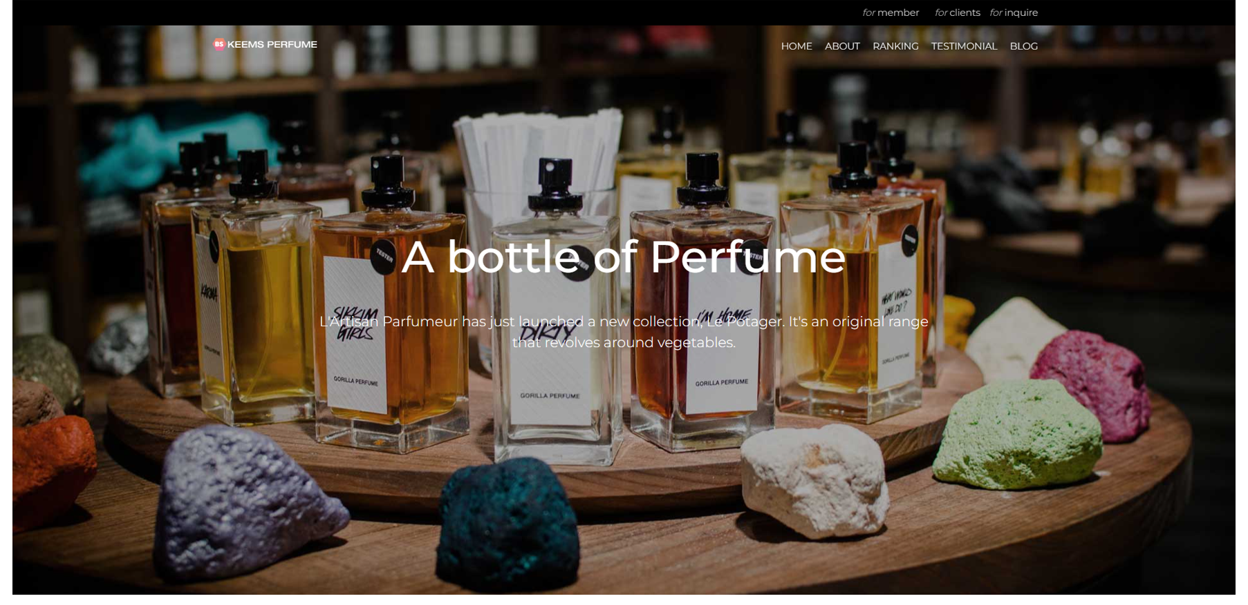
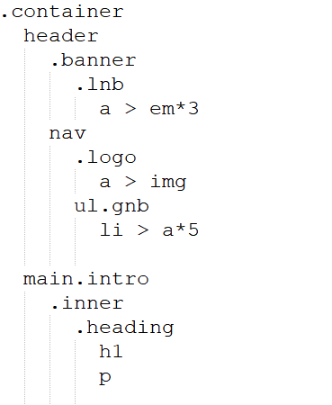
웹페이지(Web-page) : Perfume Website & App [Section : header & intro]
Header
Fixed, width: 100%
Banner : BGC: #000, height: 40px, flex, align-items: center
Lnb : width: 1300px, margin : auto, text-align: right
Nav : width: 1300px, margin : auto, flex,
justify-content: space-between, align-items: center
Gnb : flex
Into
Height: 100vh, background: url(), flex, align-items: center
Heading p : padding 0 150px
전체 웹사이트 Font
Body : Montserrat, 15px, #333
전체 웹사이트 Layout Size
Width : 1300px, margin : auto

Slide 4
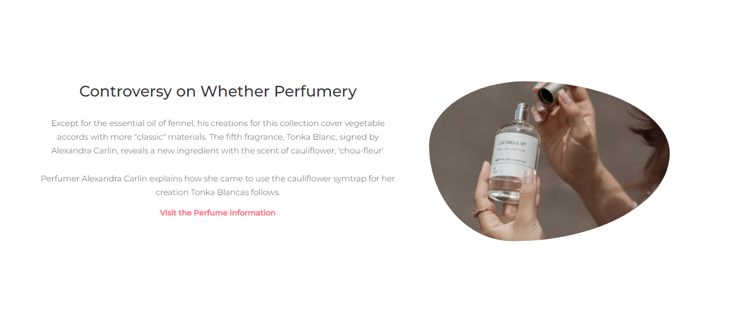
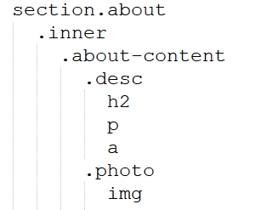
웹페이지(Web-page) : Perfume Website & App [Section : about]
About-content : flex, padding: 150px 0
Desc : flex: 3
Photo : flex: 2
Photo img : width: 100%, border-radius: 32% 68% 62% 38% / 47% 42% 58% 53%

Slide 5
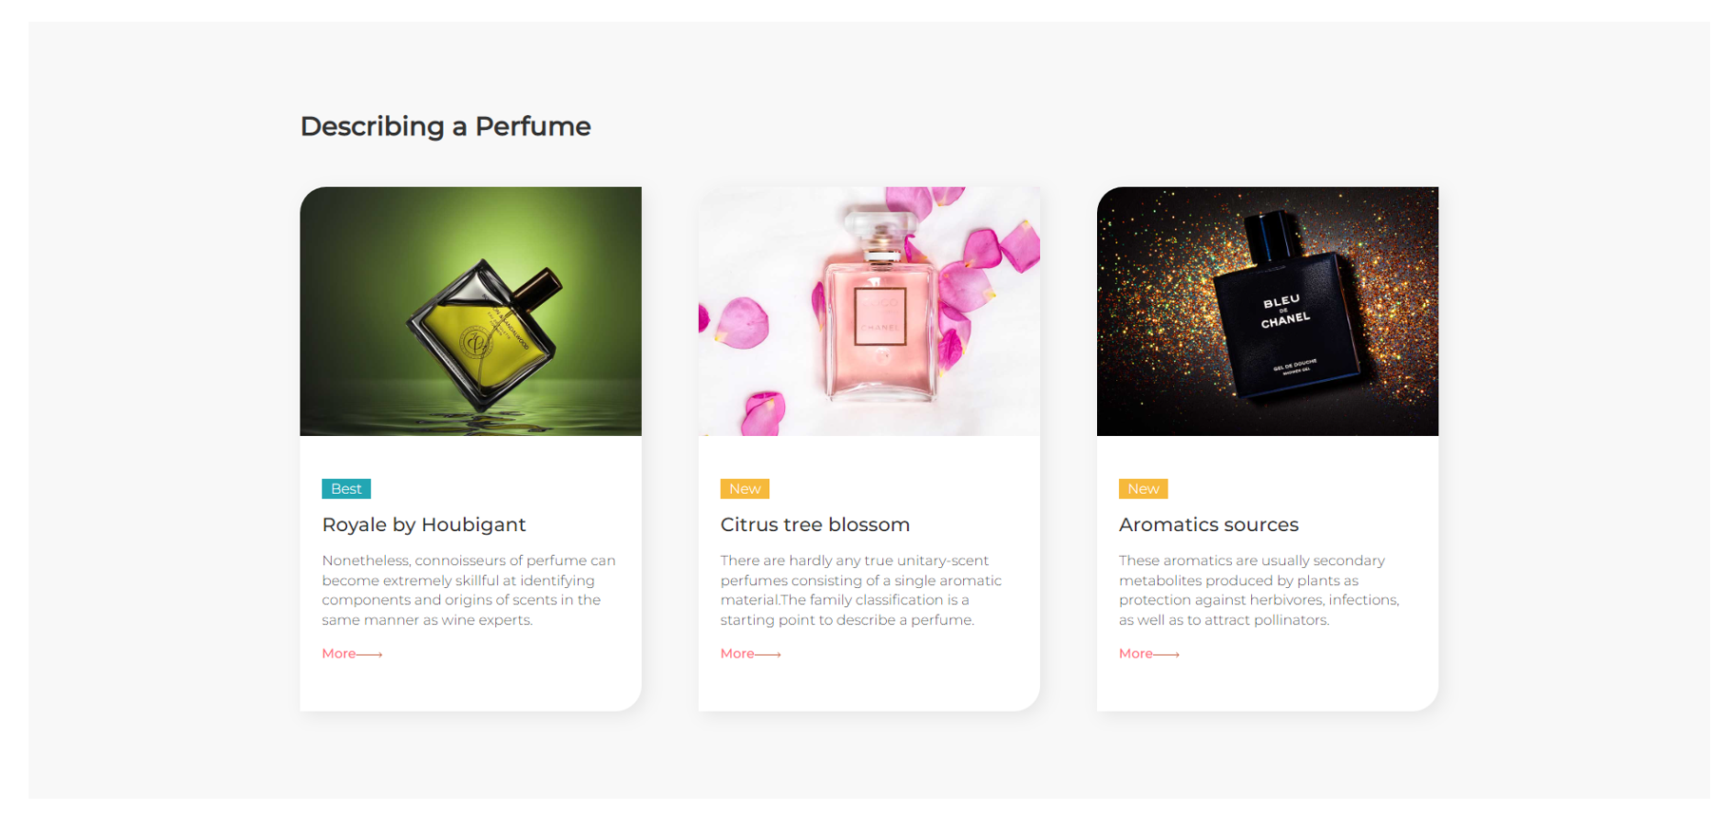
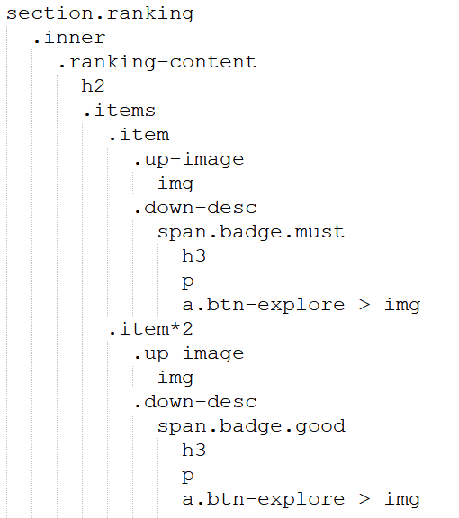
웹페이지(Web-page) : Perfume Website & App [Section : ranking]
Ranking : BGC: #f8f8f8
Ranking-content : padding : 100px 0
Items : flex, justify-content: space-between
Item : width: 390px, height: 600px, BGC: #fff, border-radius: 30px 0 30px 0, overflow
Up-image : width: 390px, height: 285px
Up-image img : height: 100%
Btn-explore:hover img : margin-left

Slide 6
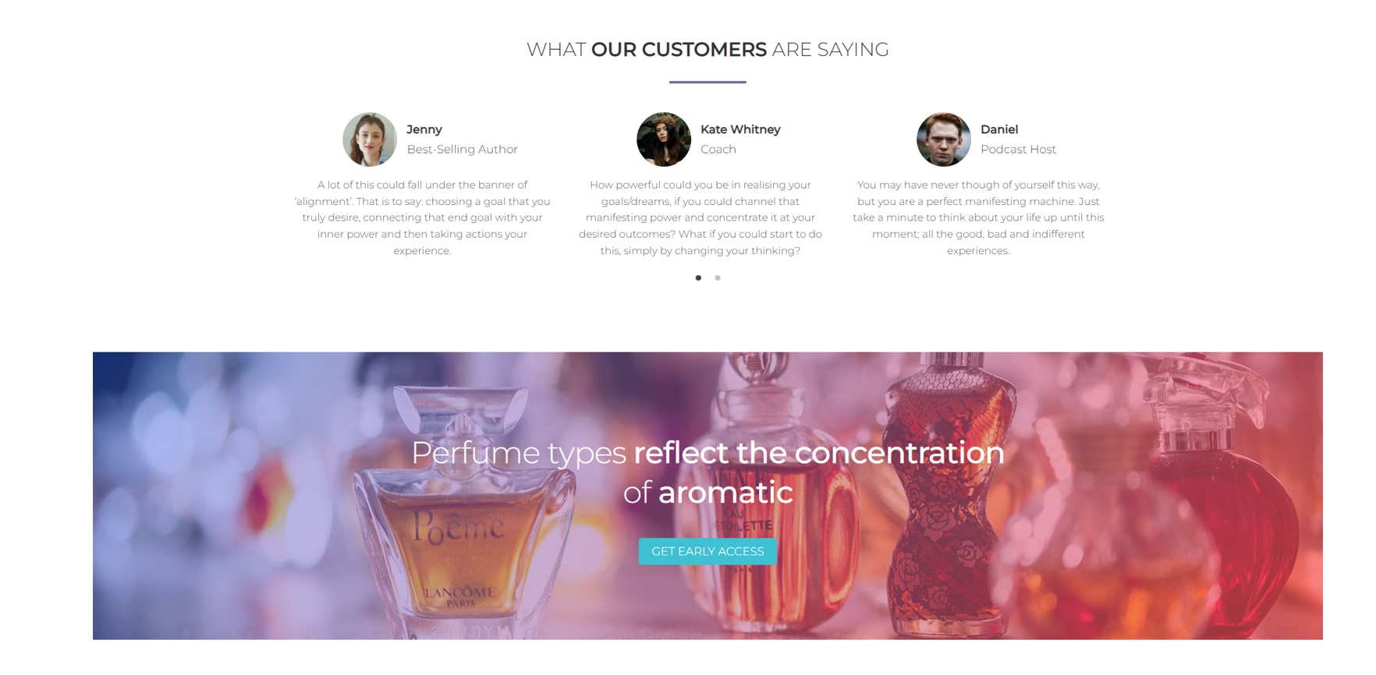
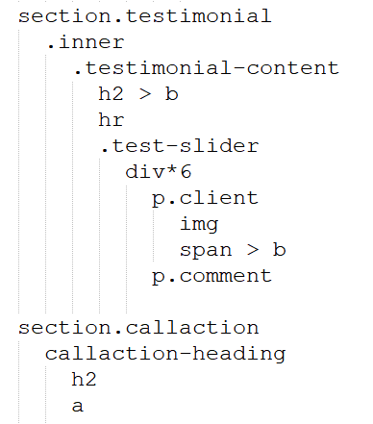
웹페이지(Web-page) : Perfume Website & App [Section : testimonial & callaction]
Testimonial
Testimonial : padding: 100px 0
Client : flex, align-items: center, justify-content: center
Client ing : width: 85px, bdrs 50%
Callaction
Callaction : height: 450px, background: url(), flex,
align-items: center, justify-content: center
Callaction::before : linear-gradient
(to right bottom, #ff08468a 0%, #f9d52396 100%)

Slide 7
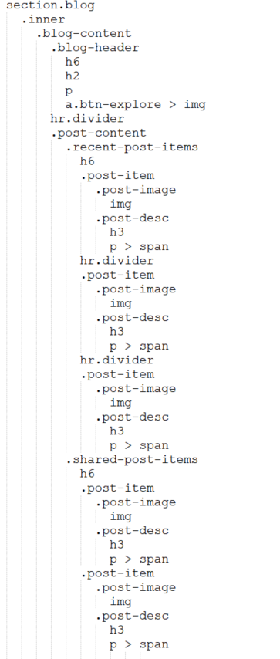
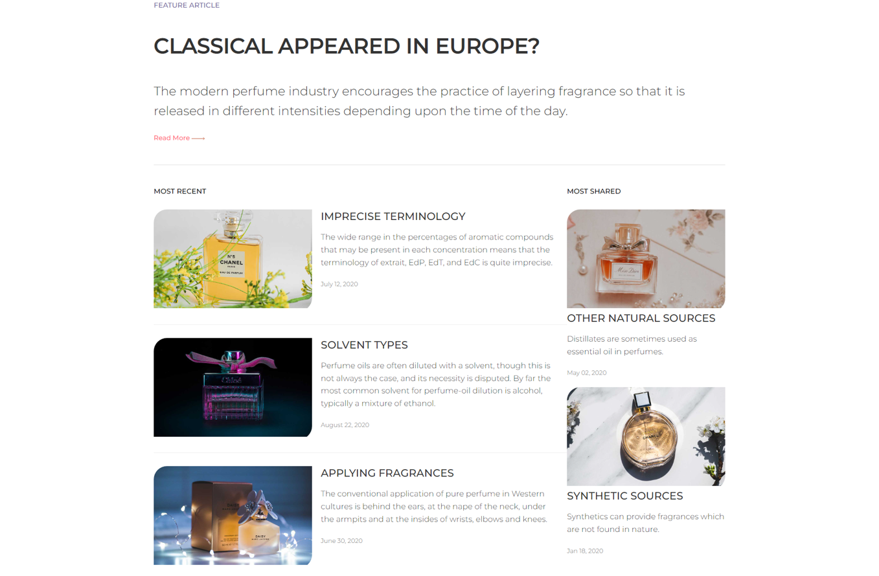
웹페이지(Web-page) : Perfume Website & App [Section : testimonial & callaction]
Blog : padding: 100px 0
Post-content : flex, justify-content: space-between
Recent-post-items : flex: 2
Shared-post-items : width: 360px
Post-item : flex
Shared-post-items .post-item : flex-direction: column
Post-image :width: 360px, border-radius: 30px 0 30px 0
Post-image img : width: 100%
Post-desc : flex: 3

Slide 8
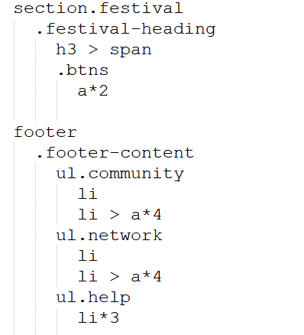
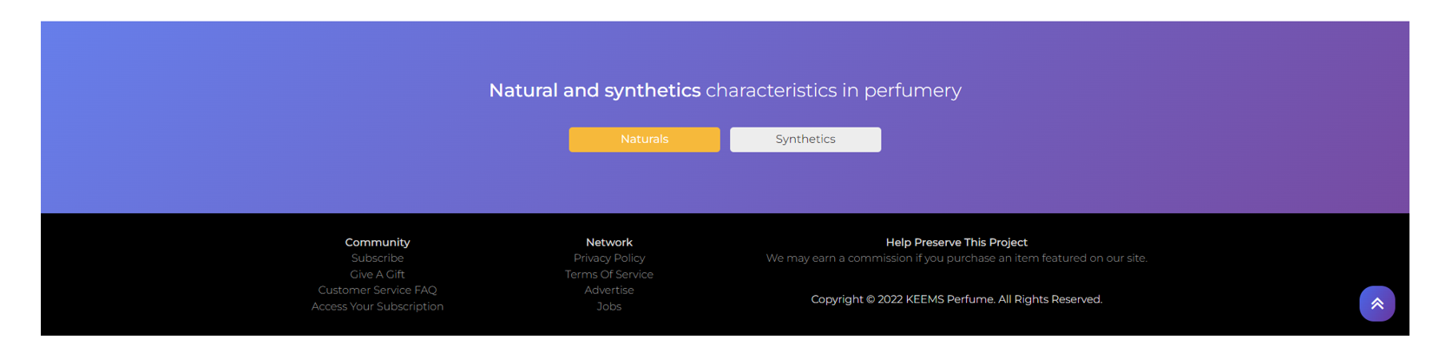
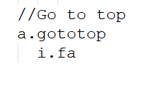
웹페이지(Web-page) : Perfume Website & App [Section : festival & footer]
Festival (banner)
Festival : height: 270px, flex, align-items: center, justify-content: center,
background-image: linear-gradient(135deg, #667eea 0%, #764ba2 100%)
Btn a : inline-blick, width: 180px, padding, margin
Footer
Footer : BGC #2C3A47, padding: 30px 0
Footer-content : flex
Community : flex: 1
Network : flex: 1
Help : flex: 2, color: #bbb
Help li:last-child : color: #eee

Slide 9
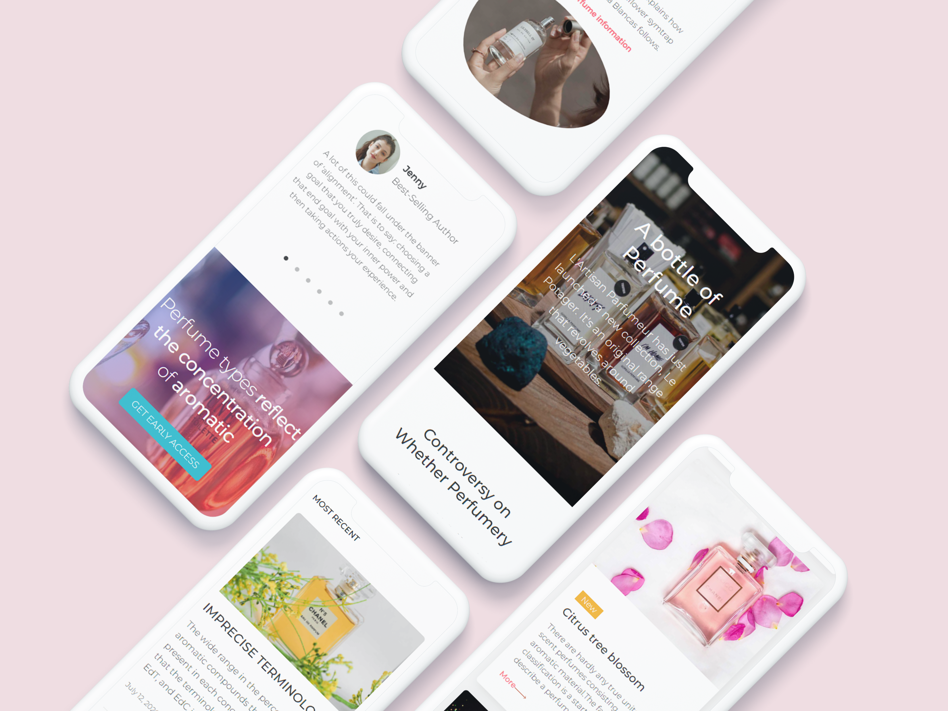
모바일페이지(Mobile-page) : Perfume Website & App

